Slide 1


by Xcodeable

Slide 2

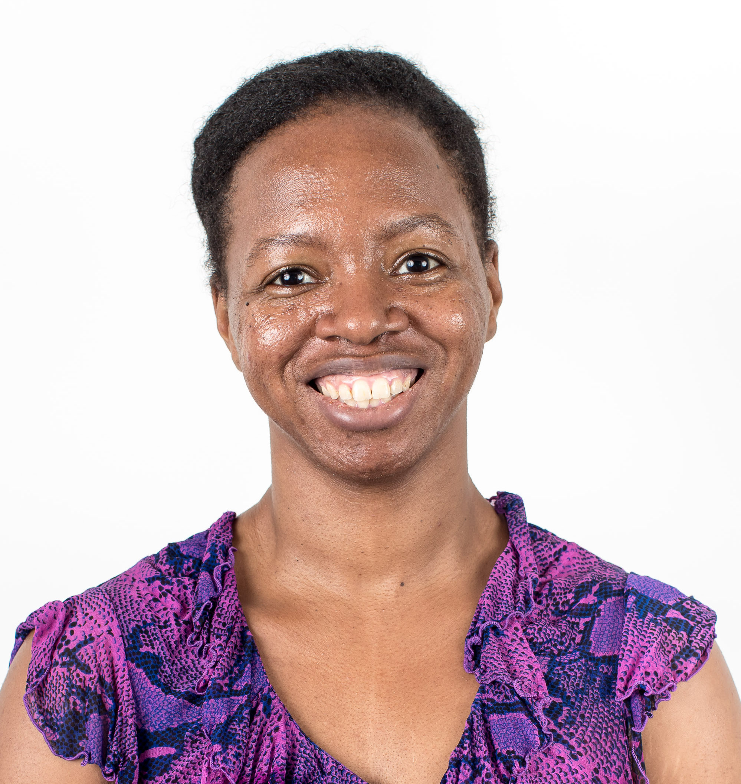
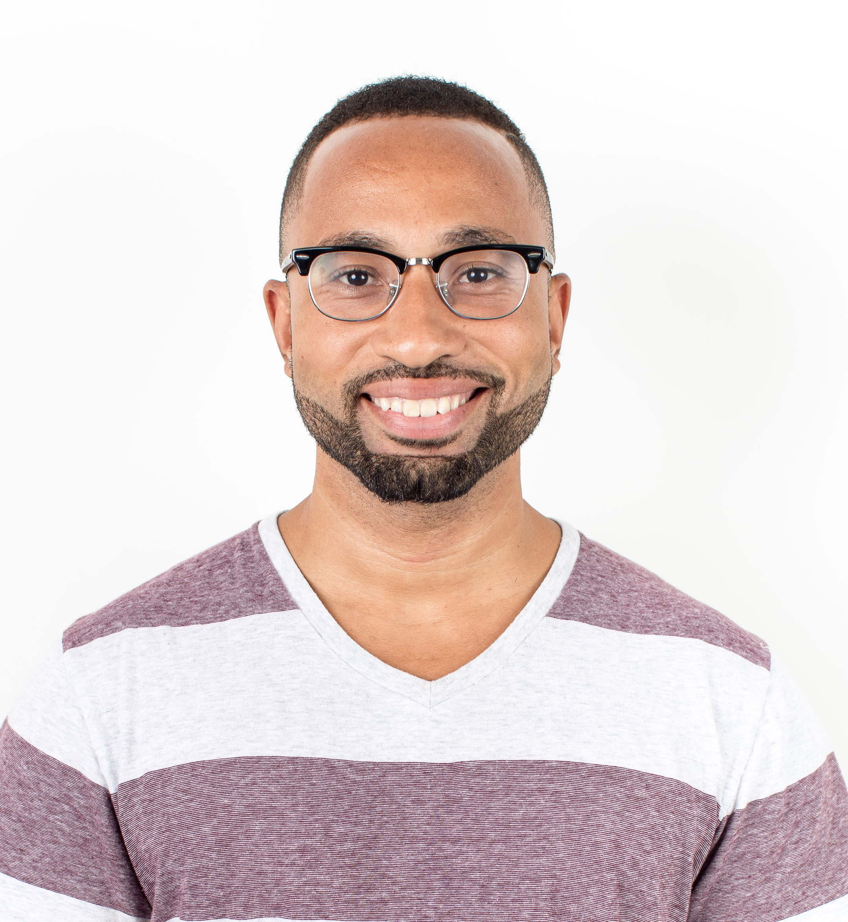
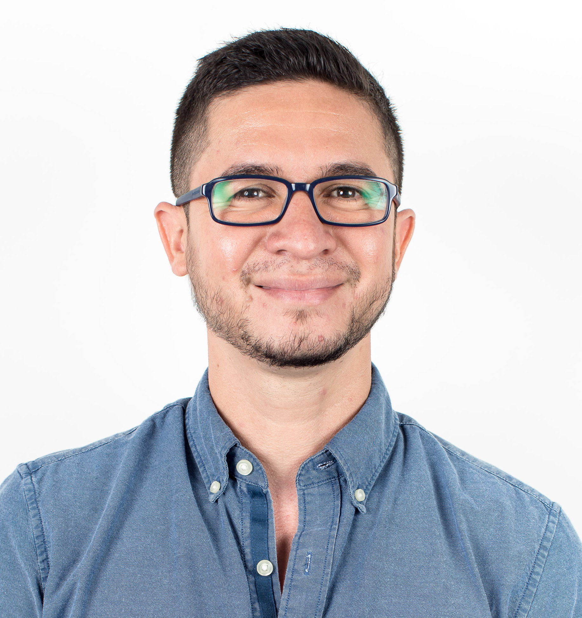
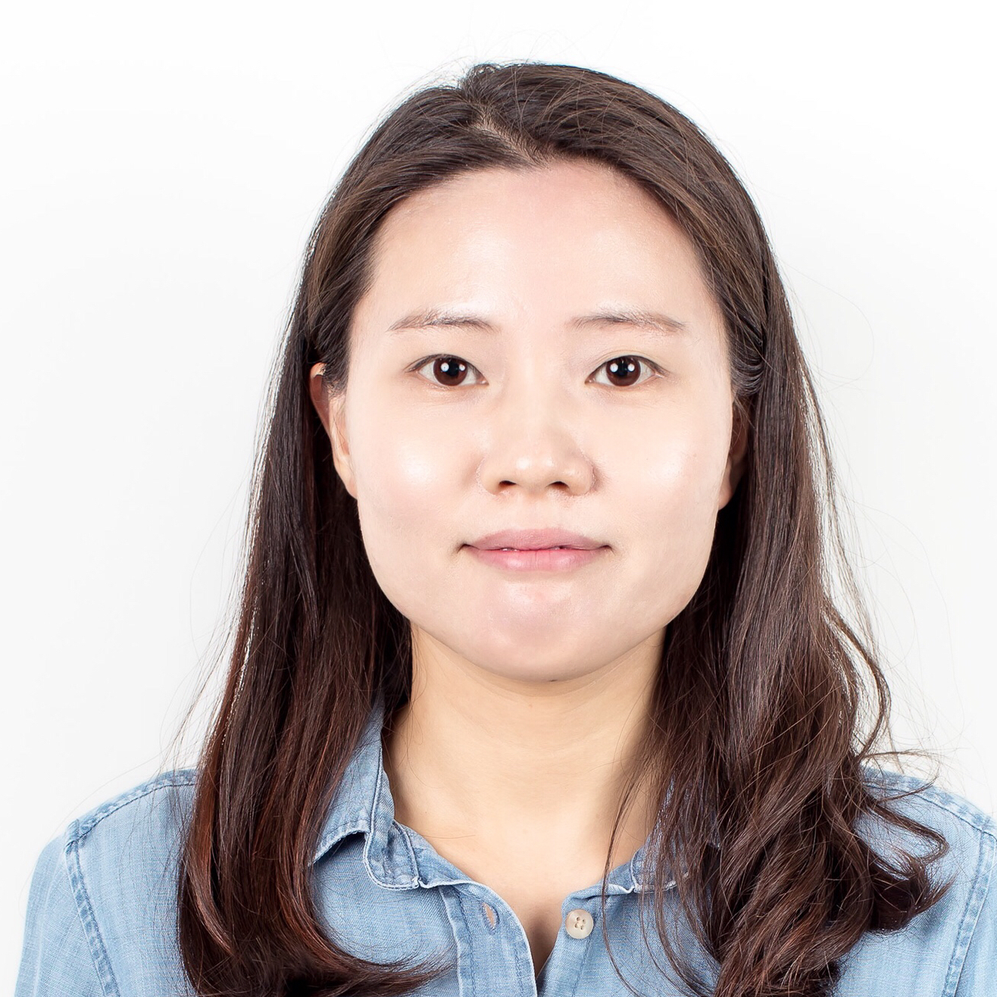
X-Codeable
Gloria Washington
Project Manager
Winston Maragh
Design Lead
Marlon Rugama
Tech Lead
Xianxian Chen
Demo Lead

Slide 3


Problem
Finding meaningful connections in a big city
Find people with similar interests
Finding a restaurant for date

Slide 4

Solution
Users match based on food preference
Bond over a simple idea
Plan a date in app

Slide 5
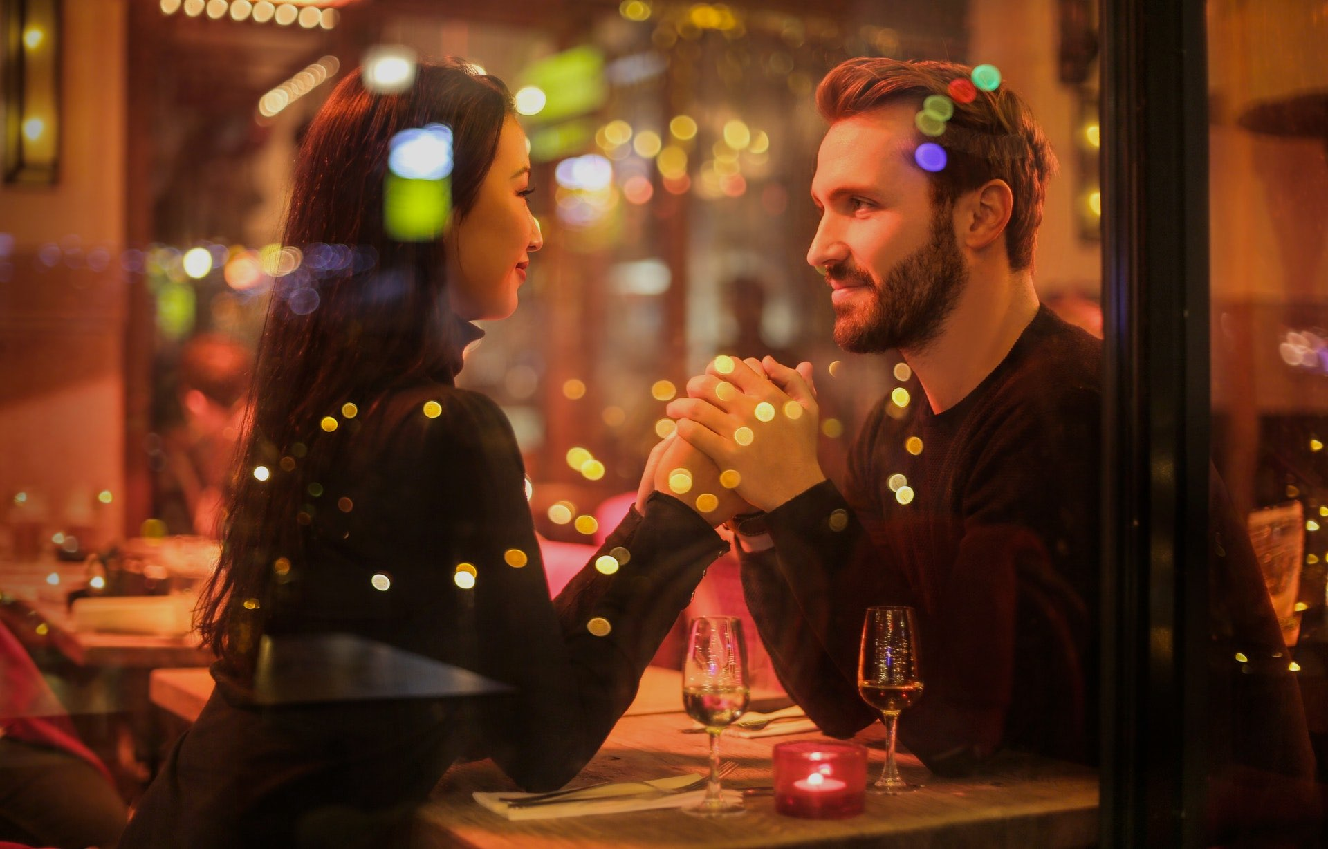
“Creating meaningful connections through food”

Slide 6
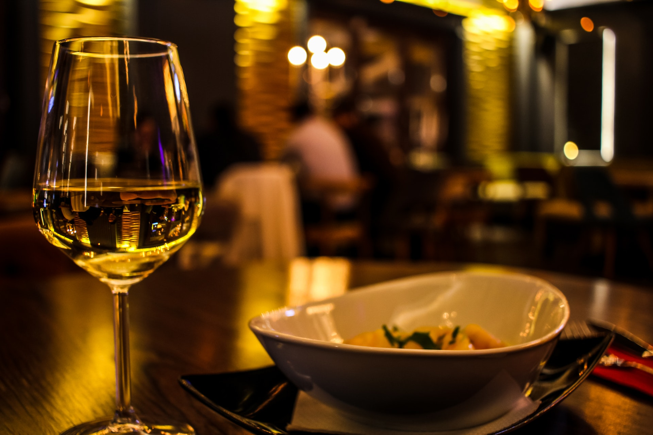
User dAting experience

Slide 7


Future Features:
Tech:
iCalendar integration
Video Chat
Restaurant reservations
Machine Learning
Business :
Partner with restaurants to provide discounts
Expand to other big cities.

Slide 8
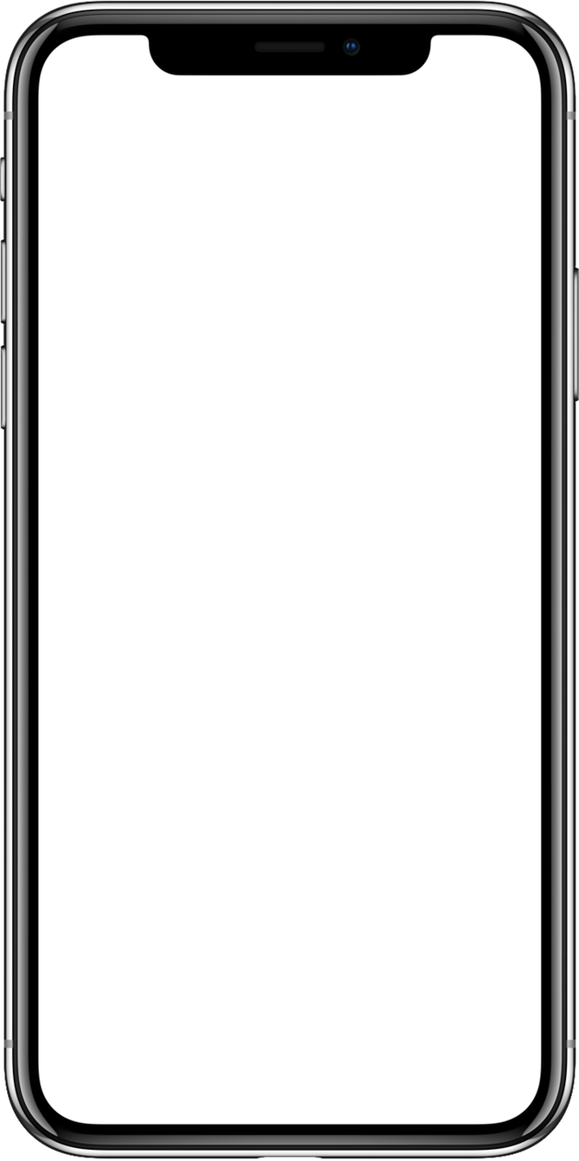
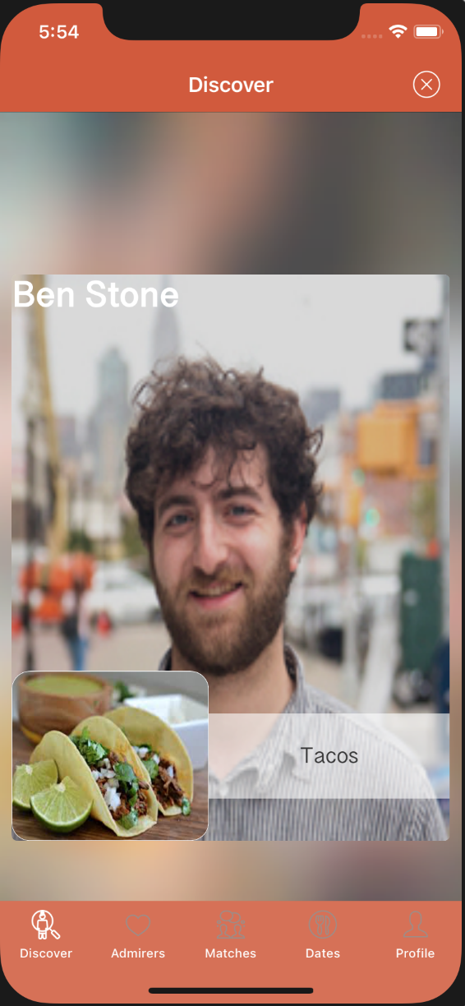
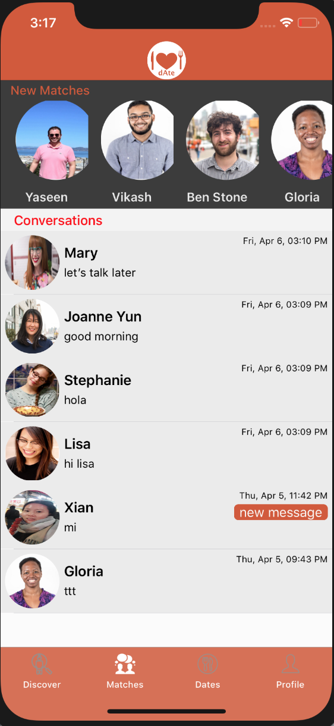
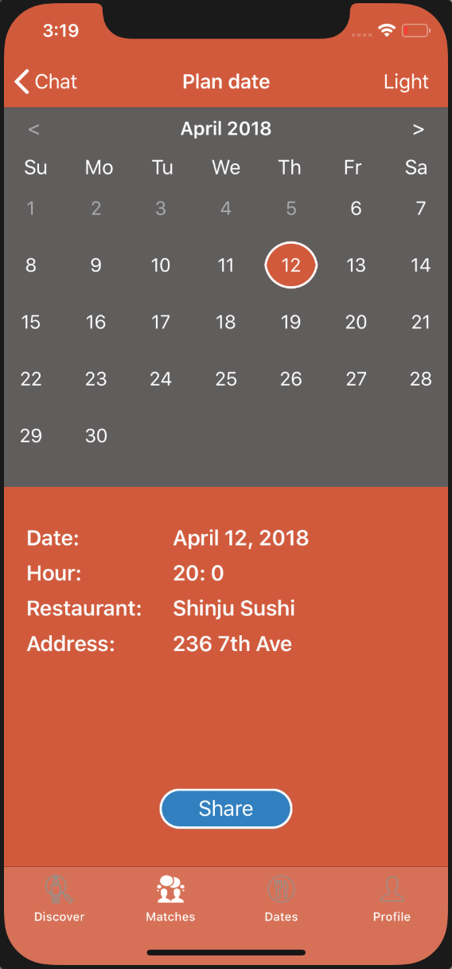
Are you single & like to eat?
Try dAte!

Slide 9


Thank You
Tom O’Malley
Justine Kay
Vincent Toms
Ben Stone
Alex Paul
Cameron Flowers
Stefani Priskos

